Slide 1
Dependency Injection (DI)
.NET Development

Slide 2
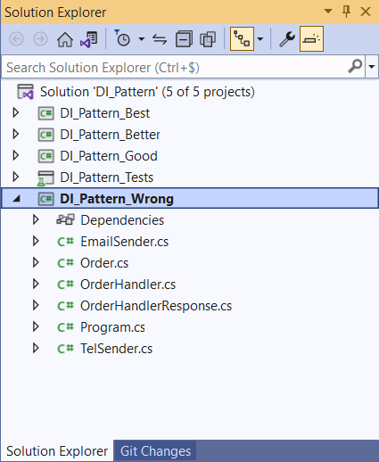
Dependency Injection
DI_Pattern - start.rar
Open DI_Pattern.sln / 5 projects

Slide 3
Wrong solution

Slide 4
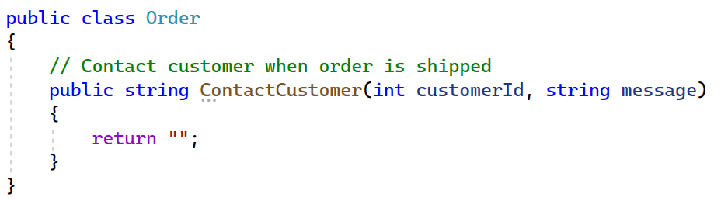
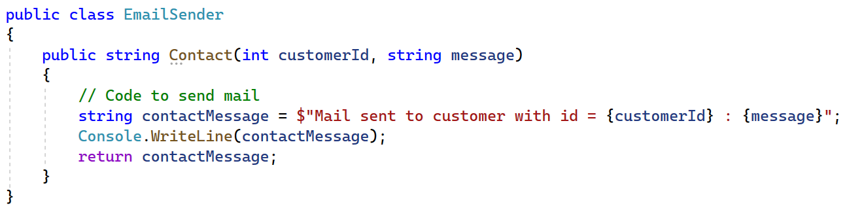
Problem / DI_Pattern_Wrong
When an order is shipped, we want to contact the customer by email
Order class
EmailSender class

Slide 5
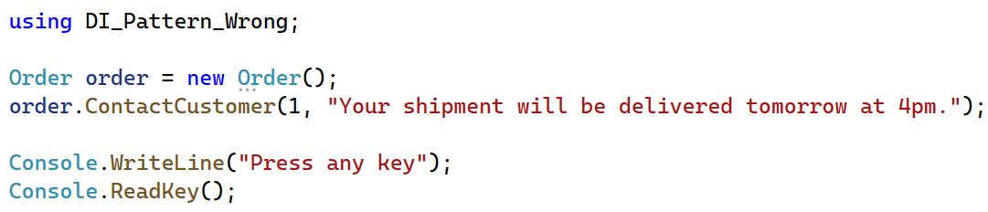
Problem / DI_Pattern_Wrong
Program.cs

Slide 6
Exercise
Run the DI_Pattern_Wrong project
Set as Startup Project!
Make sure the mail is send and “Your shipment …” is sent to customer 1 by email appears in the console.

Slide 7
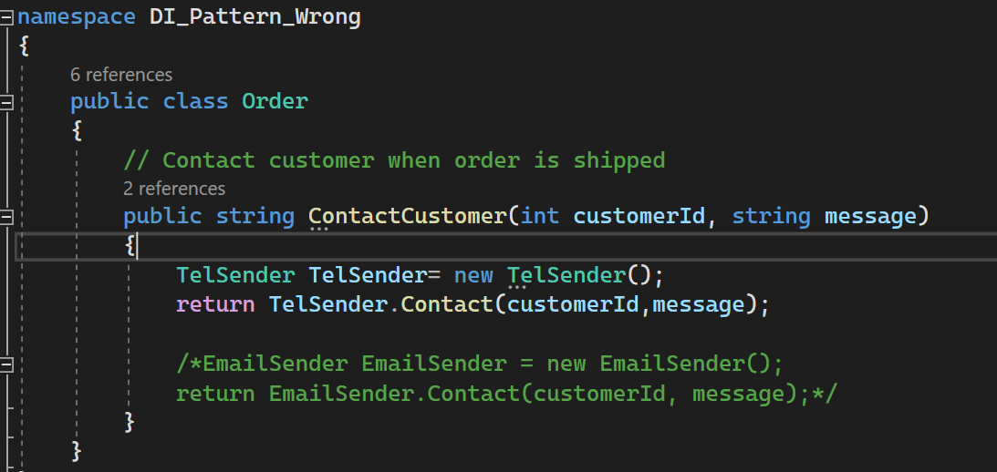
Solution
Order class

Slide 8
Solution 1 - wrong
Hard dependency (tightly coupled: Order class can't be used without EmailSender class)
Order class
uses functionality of
EmailSender class
depends on
EmailSender emailSender = new EmailSender();
return emailSender.Contact(...);
public string Contact(...) { }
It works, so it’s fine? Or not?

Slide 9
It works, so it’s Fine?
Order class has a dependency of the EmailSender class
because it creates an object of the EmailSender class
EmailSender class has functionality (Contact method) that the Order class uses
What if we decide to contact the customer by phone instead of by email?
Use the TelSender class
Exercise: Make the appropriate changes in the solution!
EmailSender emailSender = new EmailSender();

Slide 10
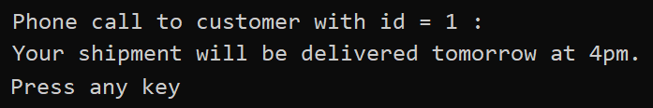
Solution

Slide 11
What did we do?
We changed our code by
Removing object creation of EmailSender class
Adding object creation of TelSender class
In case our application was already deployed, we had to recompile and redeploy it because of these code changes.

Slide 12
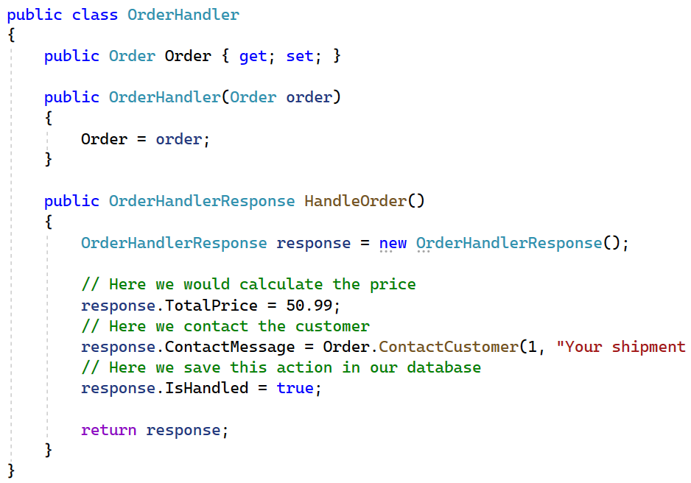
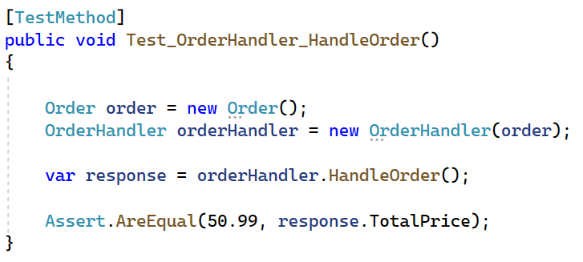
Is our code testable?
Open DI_Pattern_Tests
UnitTest_DI_Pattern_Wrong.cs
Is this ok?

Slide 13
Is our code testable?
We want to test the HandleOrder functionality from the OrderHandler class.
But the HandleOrder() method executes the ContactCustomer() method
What if this method really contacts the customer (e-mail, tel, ...)?
Is it possible to mock the TelSender class and change its behavior to help us creating good unit tests?
NO!!!

Slide 14
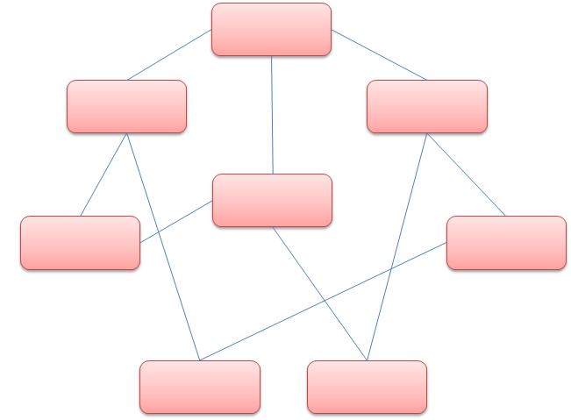
Conclusion
In Object Oriented Programming objects work together in a collaboration model where there are contributors and consumers. Naturally, this communication model generates dependencies between objects and components, resulting in an extremely difficult scenario to manage and to test when complexity increases.

Slide 15
Better solution

Slide 16
Solution 2 - good
Let’s think of a better solution.
Can we move the creation of the dependent objects (EmailSender/TelSender) outside of the class that depends on it (Order) and still be able to use these objects ?
⇨ Design principle = Inversion of control (IOC)
⇨ Design pattern = Dependency Injection (DI)
Notes:
IOC is as design principle providing some high-level guidelines to remove the tight-coupled dependencies between classes in order to make the application more decoupled, maintainable and testable.
DI is the corresponding design pattern that implements IOC and instructs us in detail how to develop loosely coupled code. Using the Dependency Injection design pattern, we can move the dependent objects creation and binding outside of the class that depends on it and provide this object differently to the dependent class.

Slide 17
IOC & DI
IOC is as design principle providing some high-level guidelines to remove the tight-coupled dependencies between classes in order to make the application more decoupled, maintainable and testable.
DI is the corresponding design pattern that implements IOC and instructs us in detail how to develop loosely coupled code.
Using the Dependency Injection design pattern means that objects do not create other objects on which they rely to do their work. Instead, they get the objects that they need from an outside source (injected).
Let's implement DI in DI_pattern_Good

Slide 18
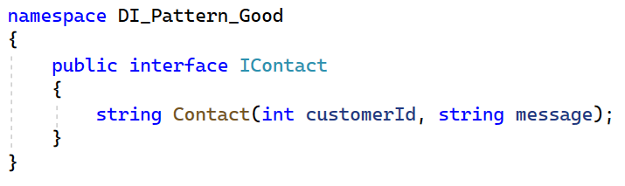
Step 1 – IContact interface
Create an interface IContact with a Contact method.
Why do you need an interface?

Slide 19
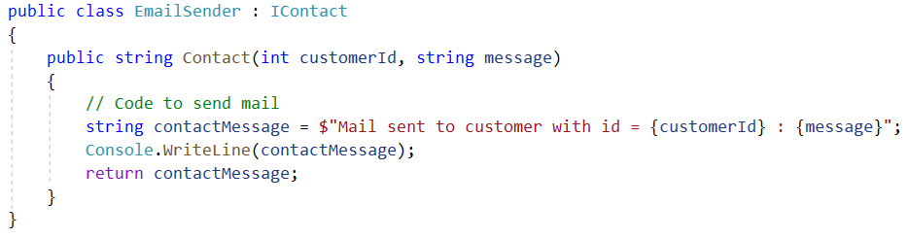
Step 1 – IContact interface
⇨ Make sure that the EmailSender class implements this interface.
⇨ Make sure that the TelSender class implements this interface.
Try to rename Contact into Call and see what happens.

Slide 20
Step 2 – Order class
We no longer create an object of the EmailSender or TelSender class in Order.
We now use the IContact interface in the constructor to inject a class which implements this interface
The order class doesn’t need to know exactly which class comes in
... but it knows that this class must implement a Contact method
= Constructor Injection

Slide 21
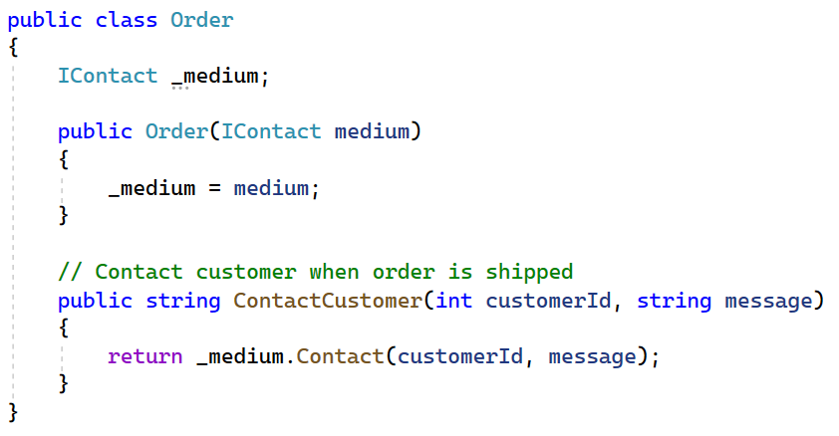

Step 2 – Order class
The incoming medium can either be an instance of EmailSender or TelSender or …
As long as it implements the interface or contract

Slide 22
Step 3 – pass the dependency
Go to Program.cs
Exercise: Create two instances of the Order class. Send a mail for the first Order and make a phone call for the second

Slide 23
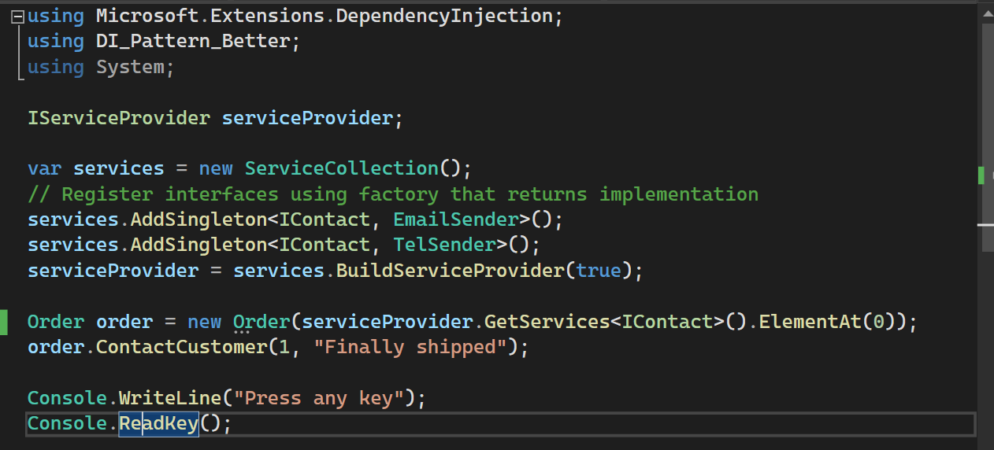
Step 3 – pass the dependency (Solution)
The dependency (EmailSender, TelSender) is now injected via the IContact interface into Order

Slide 24

Step 4 – unit test
Moq is a framework to create Mock objects
Mock objects are simulated objects that mimic the behavior of real objects (like TelSender and EmailSender), most often as part of a software testing initiative
A programmer typically creates a mock object to test the behavior of some other object, in much the same way that a car designer uses a crash test dummy to simulate the dynamic behavior of a human in vehicle impacts
Notes:
Mocks are meant as test doubles.
The concept of mocking is to simulate the input parameters and the results returned by your method.

Slide 25
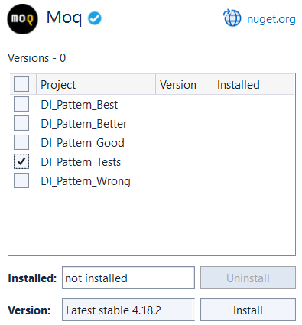
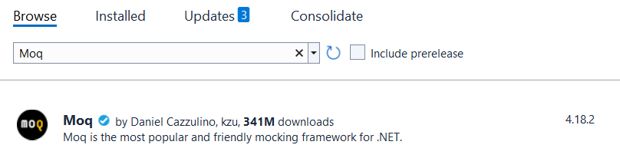
Mocking
Install latest version Moq via NuGet Package Manager
Tools | NuGet Package Manager | Manage NuGet Packages for solution...
Notes:
https://riptutorial.com/moq
Moq is a mocking library for .Net. It allows interactions with dependencies to be simulated and verified in order to facilitate unit testing.

Slide 26
Step 4 – unit test
Check the unit test class in the UnitTest_DI_Pattern_Good project.
⇨ Uncomment using Moq;
⇨ Uncomment the Test_OrderHandler_HandleOrder test.
Notes:
Mocks are meant as test doubles.
The concept of mocking is to simulate the input parameters and the results returned by your method.

Slide 27
Step 4 – unit test
Because the dependency is now injected via the IContact interface, we can simply inject a mock object
In the unit test we can simulate the execution of the Contact method so
The actual code (email, phone call) is NOT executed
We can simply return the result that we want: the return message of the Contact method
Notes:
Mocks are meant as test doubles.
The concept of mocking is to simulate the input parameters and the results returned by your method.

Slide 28
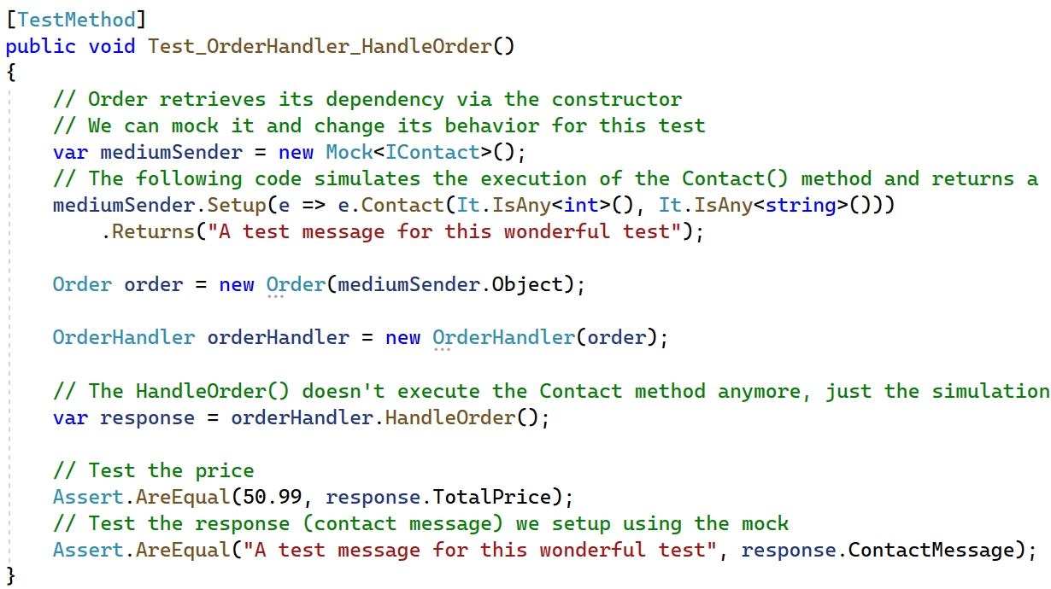
Mocking
Notes:
https://riptutorial.com/moq
Moq is a mocking library for .Net. It allows interactions with dependencies to be simulated and verified in order to facilitate unit testing.

Slide 29
Solution 3 - better
Open project DI_Pattern_Better
In solution 2:
⇨ we used an interface to abstract the dependency implementation
⇨ we injected the dependency object using the constructor
In solution 3:
⇨ we use a ServiceProvider for the registration of all dependency objects
⇨ to create this ServiceProvider we first add all dependencies to a
ServiceCollection and use BuildServiceProvider() to build
⇨ GetService() to get the service

Slide 30
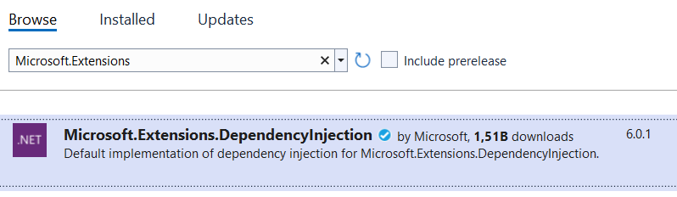
Microsoft.Extensions.DependencyInjection
Already installed using the NuGet Package Manager

Slide 31
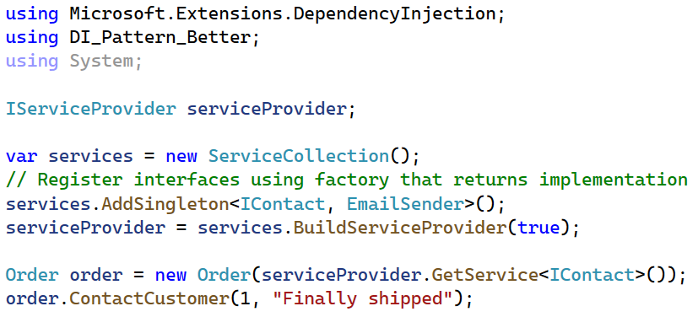
Build the ServiceProvider (Program.cs)

Slide 32
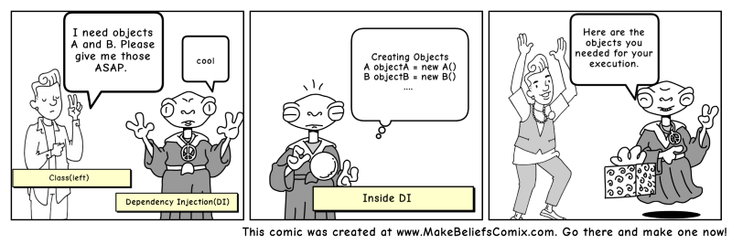
Build the ServiceProvider
Instantiate a ServiceCollection
Add pairs of interfaces and implementations as singletons to the ServiceCollection
Build the ServiceProvider.

Slide 33
Adding services
Services can be added to the ServiceCollection in 3 ways
Transient objects are always different; each call GetService() a new instance is provided
Scoped objects remain the same within a request, but different across different requests. Think of DBContext in ASP.NET MVC.
Singleton objects are the same for every object and every request.
services.AddTransient<IOperationTransient, Operation>();
services.AddScoped<IOperationScoped, Operation>();
services.AddSingleton<IOperationSingleton, Operation>();
Experiment during exercise 3

Slide 34
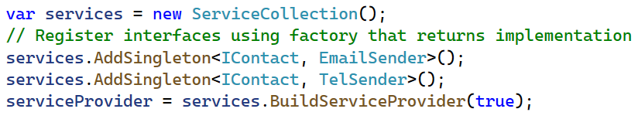
Multiple implementations of the same interface
What if we want to implement the TelSender class?
Register TelSender as an implementation of IContact
Now, we have different implementations of the same interface
serviceProvider.GetService<IContact>() Which one will you get ?

Slide 35
Multiple implementations of the same interface
serviceProvider.GetService<IContact> will always return the last registered service → Last In First Out → TelSender
serviceProvider GetServices<type>() returns an enumerable of all available services
MailSender

Slide 36
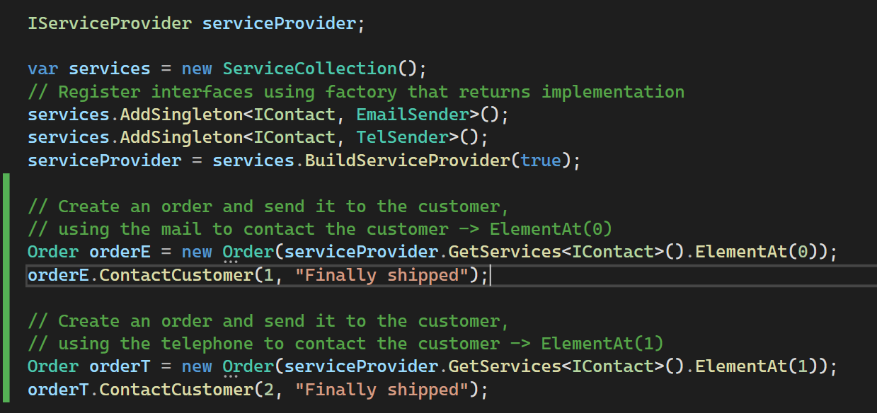
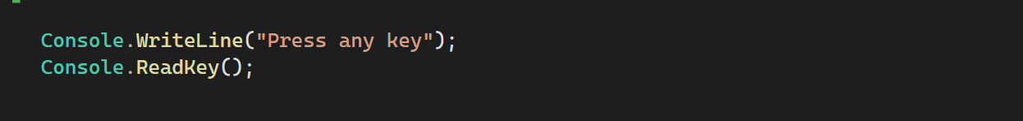

Slide 37
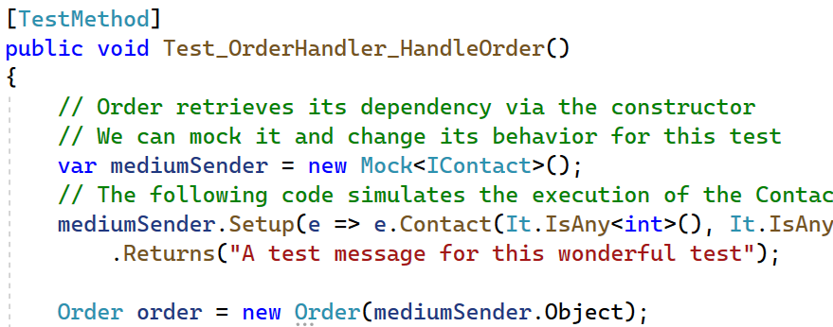
Unit test
Check the Test_OrderHandler_HandleOrder unit test class in the UnitTest_DI_Pattern_Better project.
It is the same test!
Uncomment the Test_OrderHandler_HandleOrder test. Test it out!

Slide 38
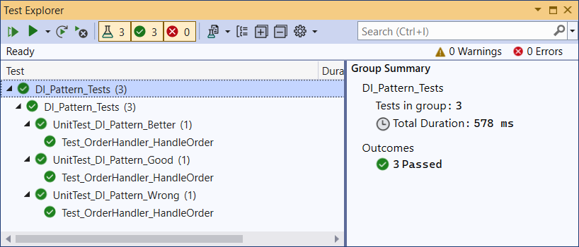
Run All Tests

Slide 39
Best solution

Slide 40
Solution 4 - best
We still have to change code if we want to use the TelSender class instead of the EmailSender class or vice versa.
⇨ What if you want to decide which implementation you want, when you install the application at the customer?
We can fix this by creating a configuration file in XML or JSON, where we describe which interface is implemented by which class.
This way we can link the EmailSender or the TelSender class to the IContact interface. If we want to switch, we just have to alter the configuration file.
In code the link between the interface and the needed implementation is still registered as a service in the project’s ServiceCollection.

Slide 41
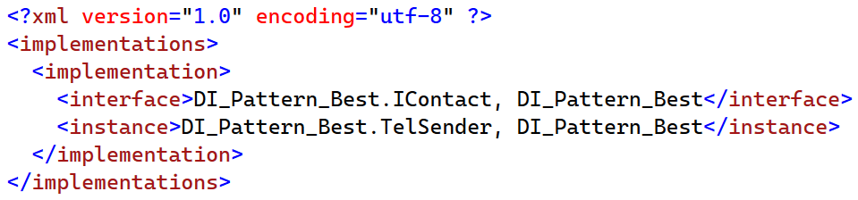
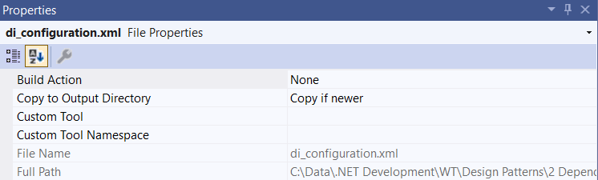
Config
XML file → config/di_configuration.xml
This customer prefers TelSender.
Notes:
Add folder + file to the project (class)

Slide 42
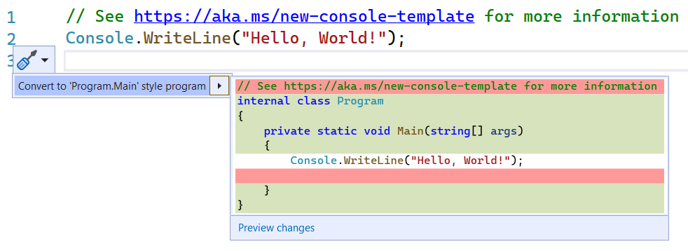
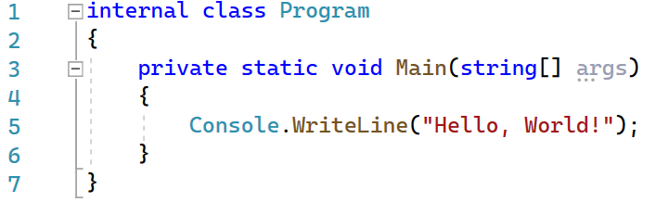
Program.cs

Slide 43
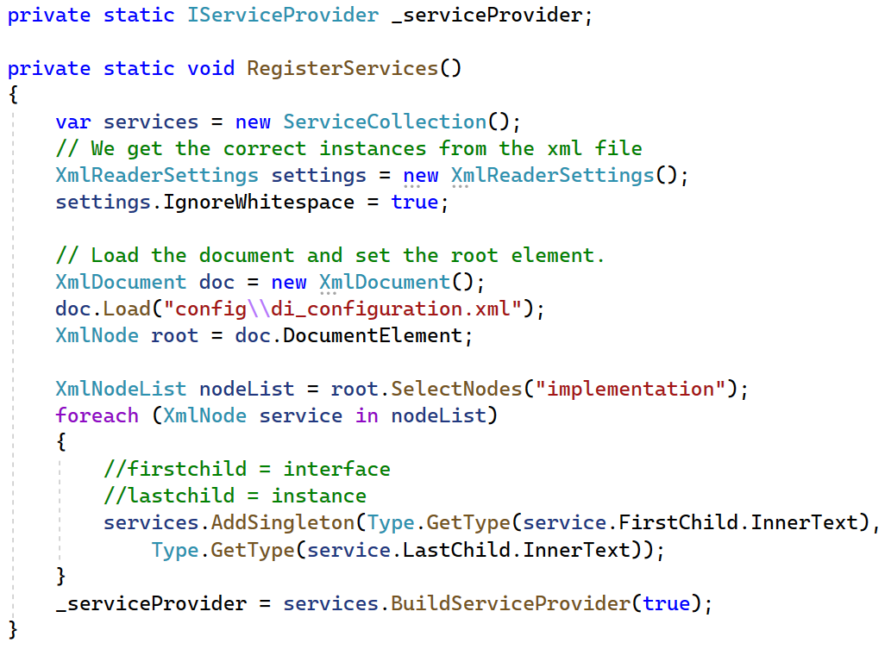
RegisterServices() in Program.cs
Notes:
private static IServiceProvider _serviceProvider;
private static void RegisterServices()
{
var services = new ServiceCollection();
// We get the correct instances from the xml file
XmlReaderSettings settings = new XmlReaderSettings();
settings.IgnoreWhitespace = true;
// Load the document and set the root element.
XmlDocument doc = new XmlDocument();
doc.Load("config\\di_configuration.xml");
XmlNode root = doc.DocumentElement;
XmlNodeList nodeList = root.SelectNodes("implementation");
foreach (XmlNode service in nodeList)
{
//firstchild = interface
//lastchild = instance
services.AddSingleton(Type.GetType(service.FirstChild.InnerText),
Type.GetType(service.LastChild.InnerText));
}
_serviceProvider = services.BuildServiceProvider(true);
}

Slide 44
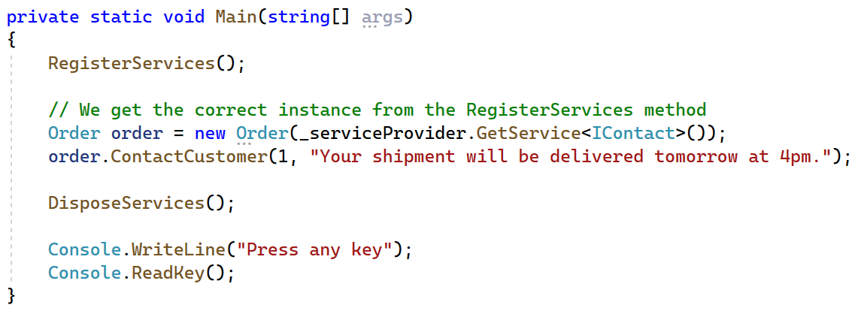
Main()
Notes:
Dispose is not necessary.
The container is responsible for cleanup of types it creates, and calls Dispose on IDisposable instances. Services resolved from the container should never be disposed by the developer. If a type or factory is registered as a singleton, the container disposes the singleton automatically.

Slide 45
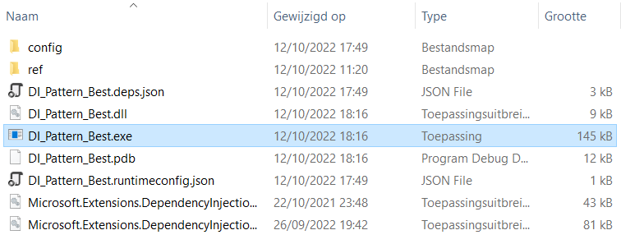
Without compilation
DI_Pattern_Best\bin\Debug\net6.0\DI_Pattern_Best.exe

Slide 46
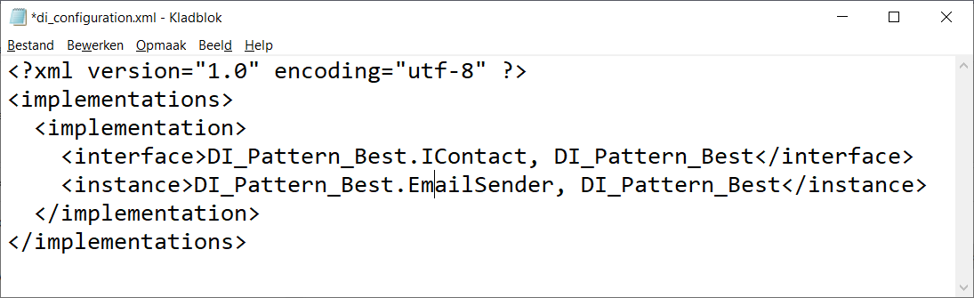
Without compilation
DI_Pattern_Best\bin\Debug\net6.0\config\di_configuration.xml

Slide 47
Without compilation
DI_Pattern_Best\bin\Debug\net6.0\DI_Pattern_Best.exe
Notes:
Exercise part 4 music store:
Create interface
create two implementations of interface implement the services in program.cs: add scope add both discounts Exercise part 5 music store:
Index controller: cal get discount with viewback (or viewmodel)
Adjust total with viewbag

